Slide 1
EMBRACING YOUR TRANSFER LENSES
SCTCS Teaching + Learning Tuesday | June 18, 2019
National Institute for the Study of Transfer Students
www.nists.org | nists@ung.edu

Slide 2

Introductions
Lenses Overview
Transfer Landscape
Lenses Framework
Discussion
OBJECTIVES

Slide 3

WHO IS HERE?
Institution Type
Current Role
Notes:
Judith

Slide 4

WHO AM I?
Emily Kittrell, M.S.
Assistant Director
emily.kittrell@ung.edu
Notes:
Judith

Slide 5





EDUCATION
OUR MISSION
Empowering professionals, faculty, and administrators to be transfer champions who challenge the status quo to improve the transfer student experience.
RESEARCH
ADVOCACY

Slide 6
1
AGENT
TRANSFER
CHAMPION
2
CONNECTOR
3
ADVOCATE

Slide 7


Despite research, institutional programs, and a national agenda focused on transfer students, institutions have not moved the needle for transfer student completion over the past several decades.
Mark Allen Poisel & Sonya Joseph

Slide 8


Slide 9

*Assumptions *Attitudes *Culture *Expectations
*Experiences *Emotions *Motivation
9

Slide 10
“I CAN’T DO THAT”
REFERRALS
DISENGAGED
TIME CONSUMING
ORIENTATION & REGISTRATION
CUSTOMER SERVICE
CLUELESS
COMPASSION
ARROGANT
10

Slide 11

Nick*
“Hey, remember me?”
*This guy is not the real Nick, but the similarity is striking!

Slide 12
WHAT’S MY ROLE?
MULTIPLE IDENTIES
CREDIT ISSUES
ORIENTATION & REGISTRATION
CUSTOMER SERVICE
DIFFUSE & WRONG INFORMATION
COMPASSION
UNCLEAR PATHWAYS
12
Notes:
Primary perspective remained the same, but could vividly see the many barriers that can so easily derail the transfer journey.

Slide 13

How to help transfers succeed

Slide 14
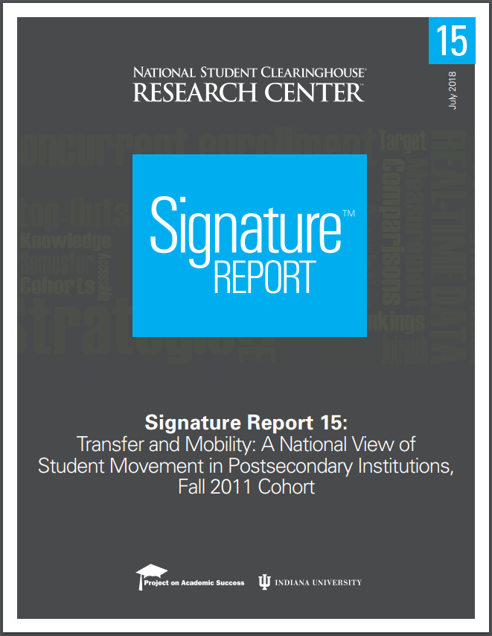


Slide 15

#15
Figure 1
2.8M
38%
33%
FIRST-TIME STUDENTS,
FALL 2011 COHORT
62%
Non-Transfers
Transfers

Slide 16


TRANSFER POPULATION
historically
underrepresented
first generation
low income
22 yrs and older

Slide 17

TRANSFER PATHWAYS
2YR – 4YR
4YR – 4YR
4YR – 2YR
2YR – 2YR

Slide 18
TRANSFER OUTCOMES
?

Slide 19

TRANSFER EXPERIENCE

Slide 20
TRANSFER EXPERIENCE
Credit Loss
Unclear Pathways
Limited Access to Advisors
Diffuse & Wrong Information
Lack of Financial Support
Misaligned Curriculum
Course Availability
Notes:
On the front end: Barriers to Enrollment

Slide 21


Notes:
Once you get in, the transition can still be a challenge.

Slide 22

DEMOGRAPHIC
MISSION
PERSONAL
FUNDING
ACADEMIC
PERSONNEL
FINANCIAL
POLICIES
SOCIAL
PROGRAMS
Notes:
And it’s no wonder! Transfer students have incredibly diverse needs and identities, and we’re asking them to navigate not one but two often very difference institutions.

Slide 23
College
is too expensive!
STATE/SYSTEM INITIATIVES
It takes
too long to finish!
AFFORDABILITY
COMPLETION
Dual & Joint Enrollment
Free Community College
Reverse Transfer
Degree Pathways
DevEd Reform
The pipeline is broken!
We need skilled workers!
ACCESS
eEd / CTE

Slide 24
TRANSFER STUDENT EXPERIENCE
?

Slide 25
Only when we understand the broad context for and implications of our work will we be best equipped to proactively design the high-quality and student-centered supports our students need to get them through the transfer transition.

Slide 26

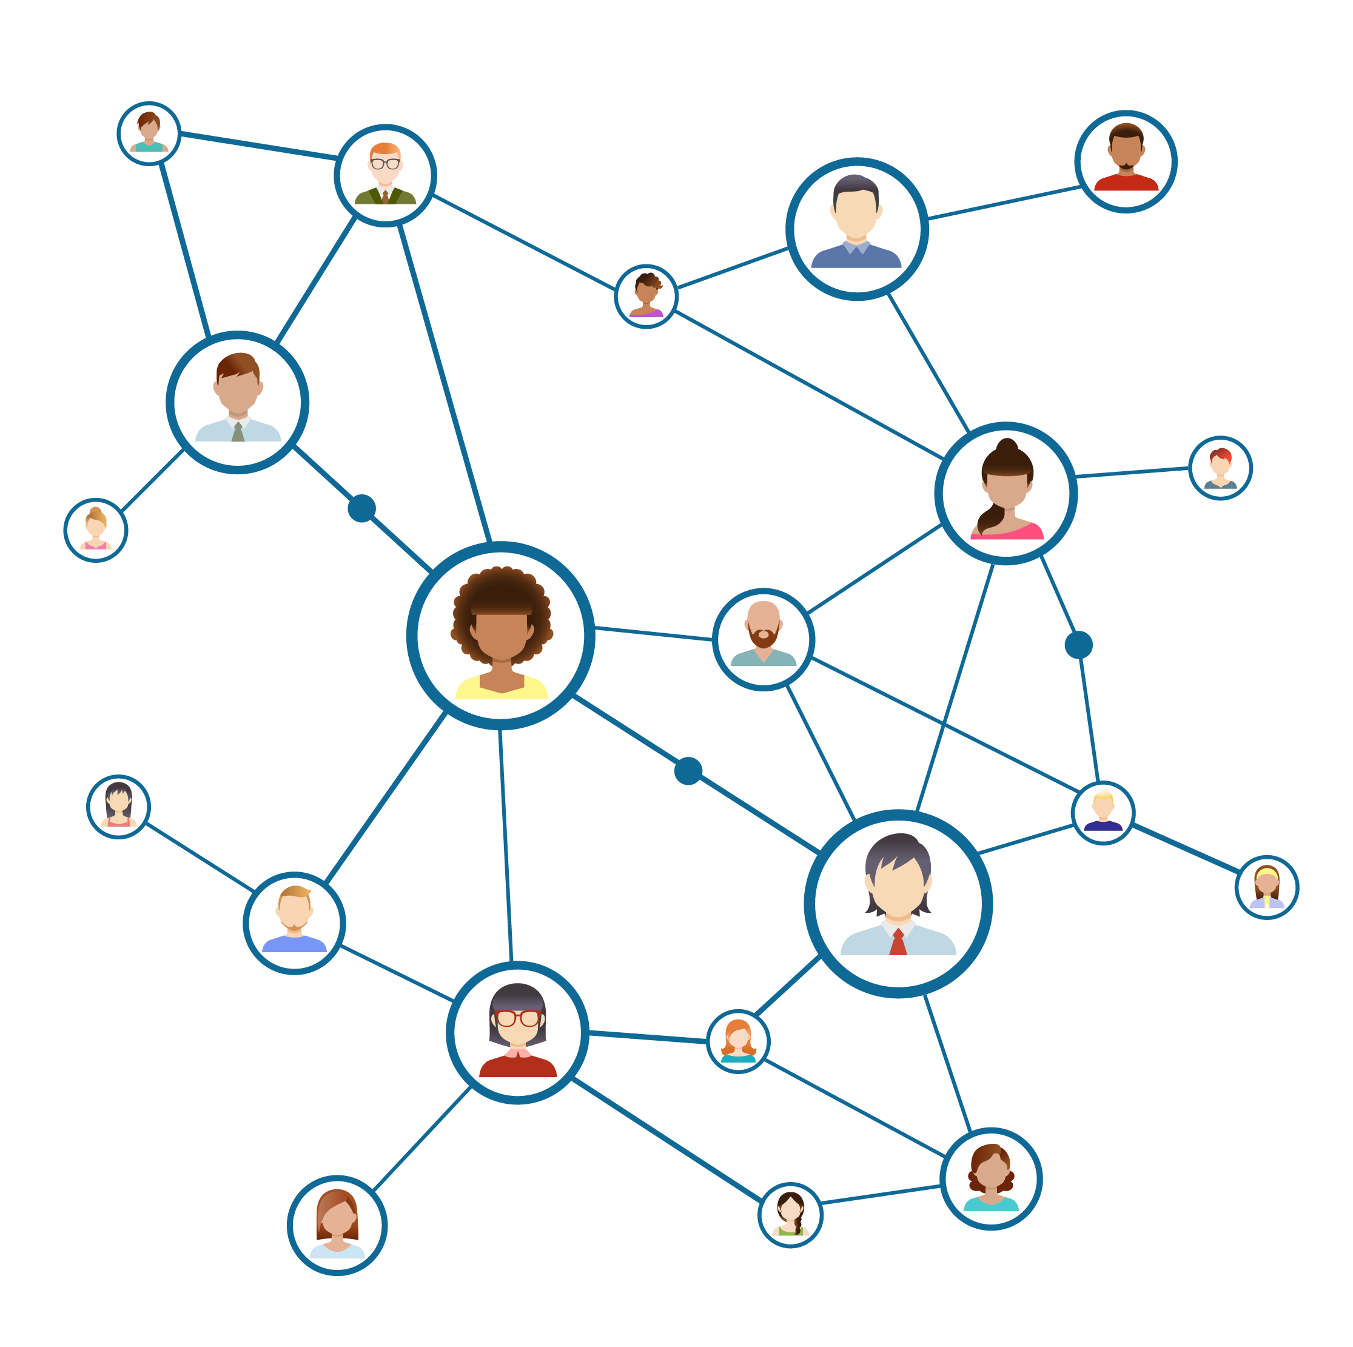

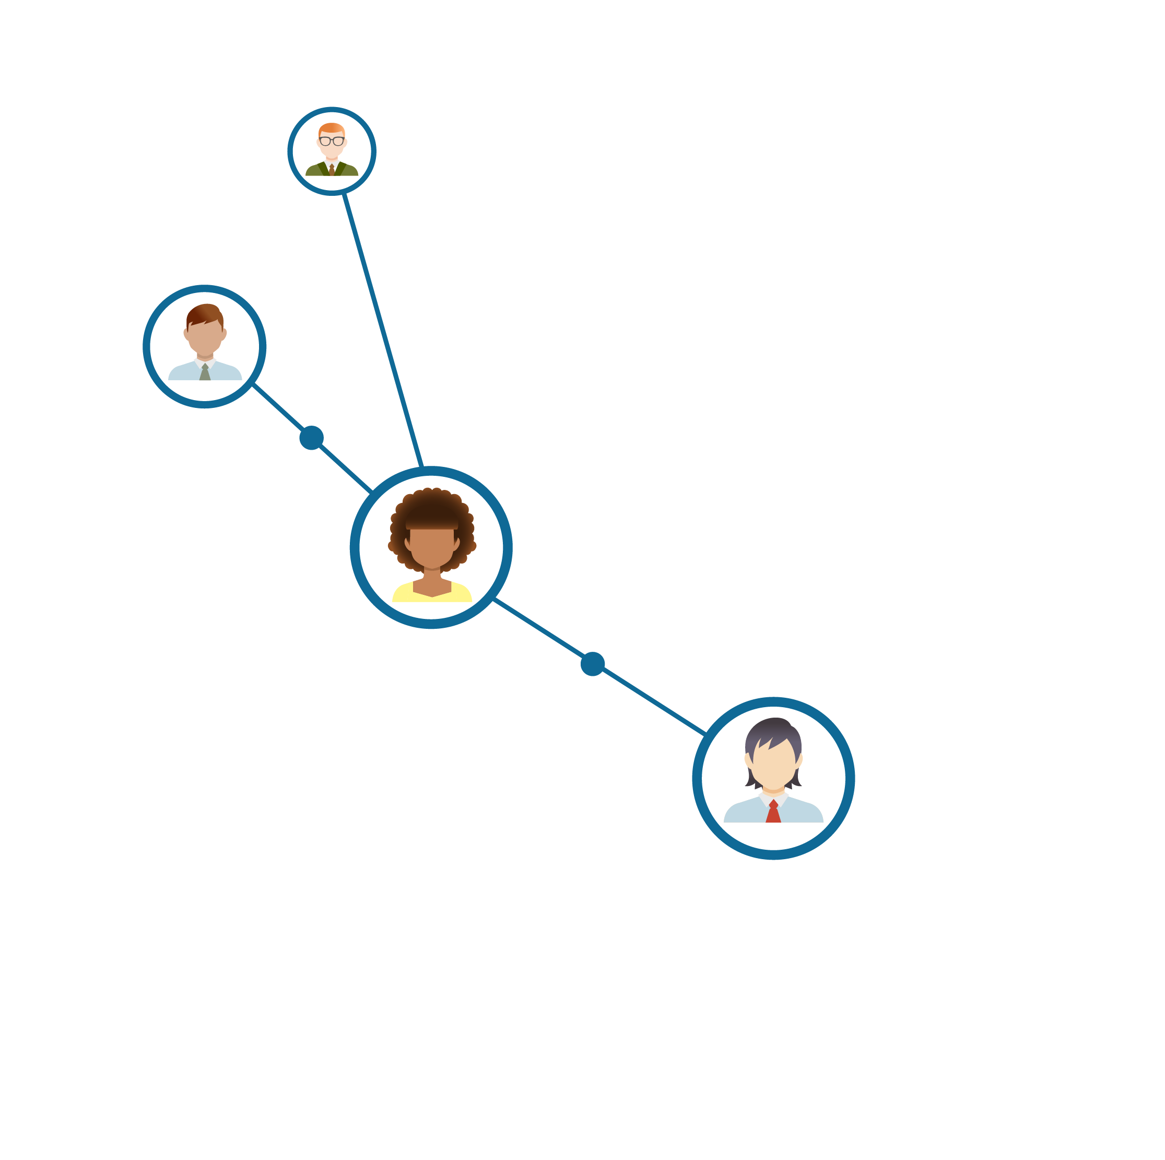
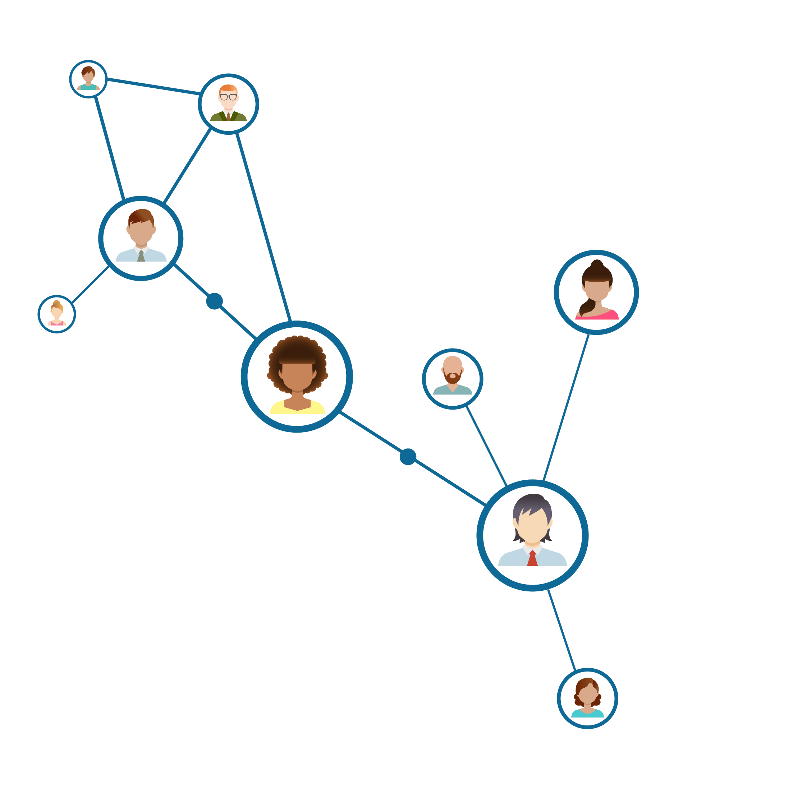
CONTEXT FOR

Slide 27



CONTEXT FOR
&
IMPLICATIONS OF

Slide 28


Slide 29



LENSES LEARNING FRAMEWORK
Transfer landscape
Transfer student experience
Transfer advocacy

Slide 30

TRANSFER LANDSCAPE
KEY AREAS:
Higher Ed. Climate
Changing Enrollment Patterns
External Mandates

Slide 31
TRANSFER LANDSCAPE
What’s happening in transfer—nationally, state-wide, and locally?

Slide 32
TRANSFER LANDSCAPE
How might these emerging issues or trends directly impact my work?

Slide 33
TRANSFER LANDSCAPE
What do I need to know or do to navigate potential changes?

Slide 34

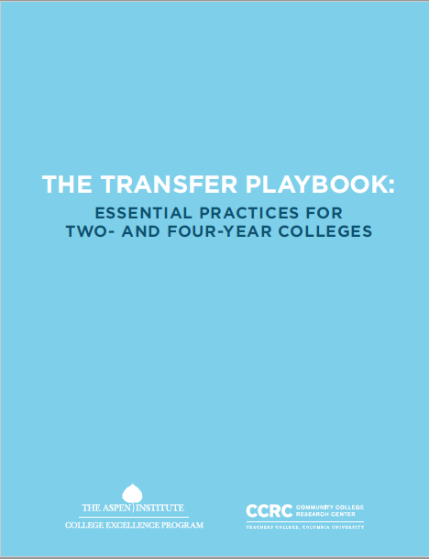

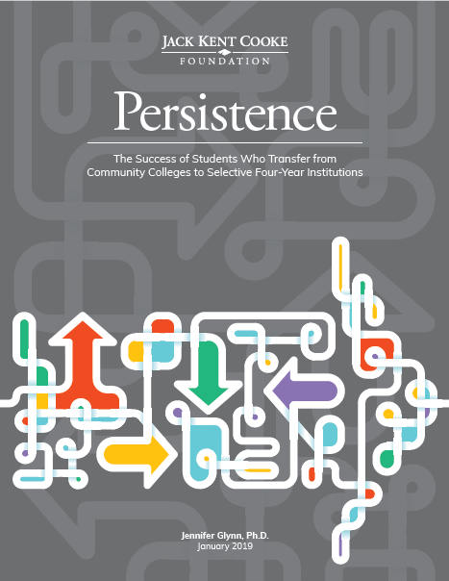
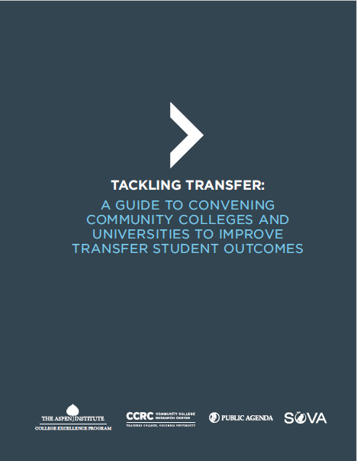

TRANSFER LANDSCAPE

Slide 35
TRANSFER LANDSCAPE
MOBILITY IS REALITY
And will have a local trickle-down effect.

Slide 36

TRANSFER STUDENT EXPERIENCE
KEY AREAS:
Transfer Student Lifecycle
Diverse Student Needs & Identities
Transfer Programs & Services

Slide 37
TRANSFER STUDENT EXPERIENCE
Does our infrastructure facilitate a smooth transition into and between institutions?

Slide 38
TRANSFER STUDENT EXPERIENCE
Do I really know how our students are preparing for and experiencing the transfer transition, or am I making assumptions?

Slide 39
TRANSFER STUDENT EXPERIENCE
Am I helping students see the big picture of their college journey and prepare for what’s coming next?
(academically, socially, financially, career-wise, etc.)

Slide 40
TRANSFER STUDENT EXPERIENCE
Are we offering students enough support so that they can acclimate
and engage with their campus communities, both academically
and socially?

Slide 41

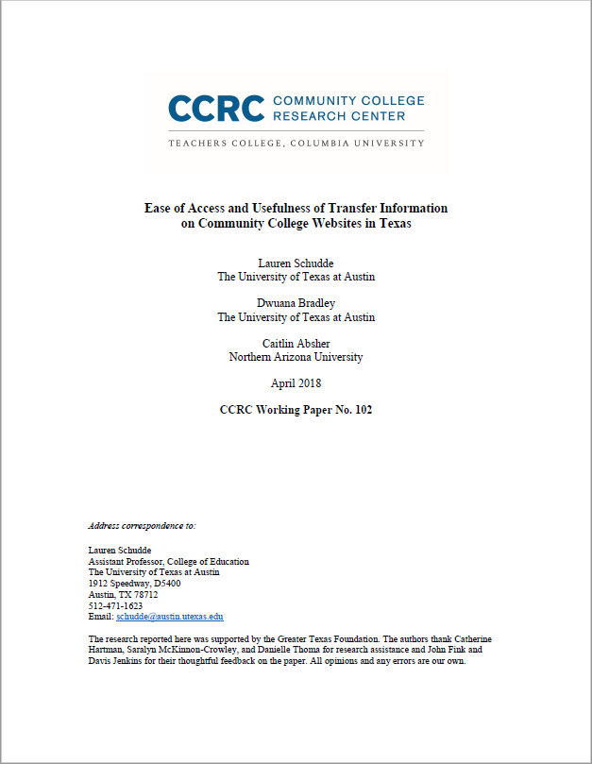

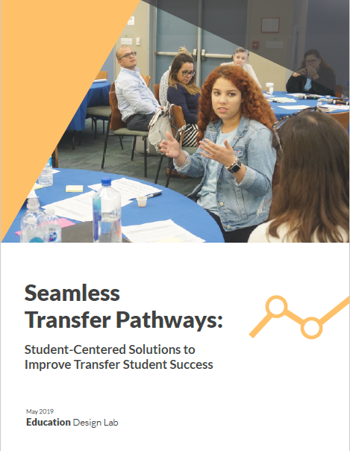
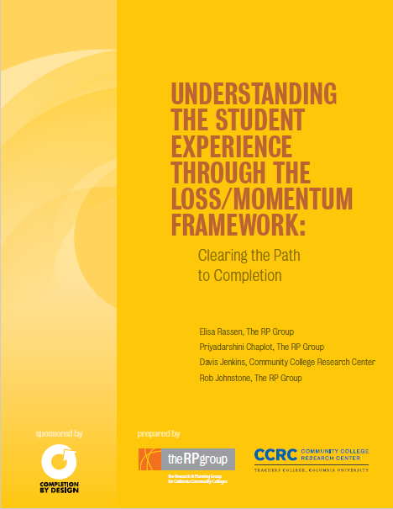
TRANSFER STUDENT EXPERIENCE

Slide 42
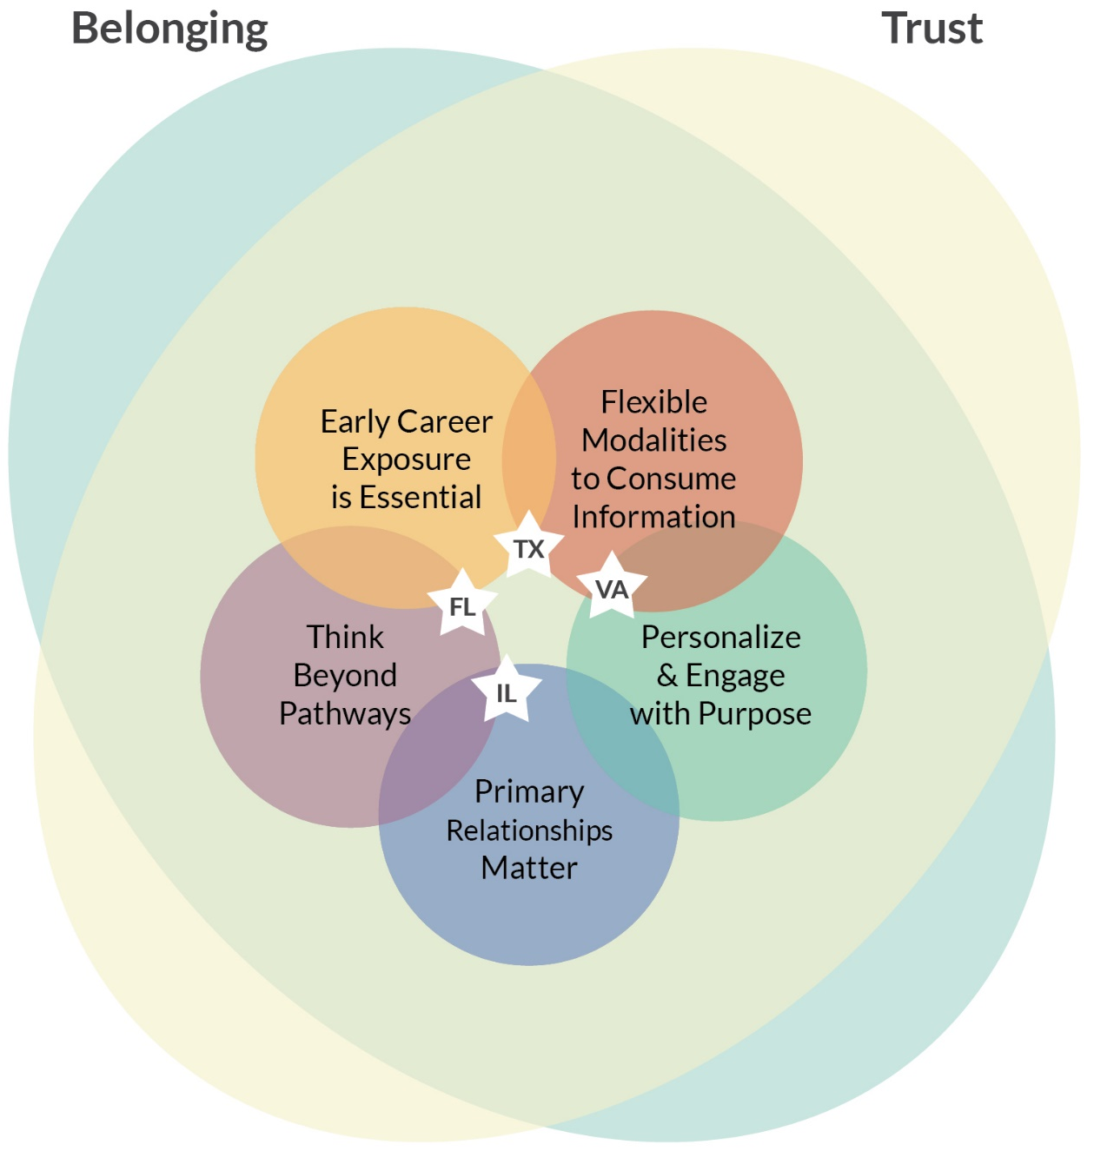
SEAMLESS TRANSFER PATHWAYS:
EMERGING TRENDS

Slide 43
TRANSFER STUDENT EXPERIENCE
TRANSFER IS COMPLEX
Every interaction is an opportunity.

Slide 44

TRANSFER ADVOCACY
KEY AREAS:
Transfer Culture
Partnerships & Collaborations
Intentional Communication

Slide 45
TRANSFER ADVOCACY
How transfer-affirming/ -receptive
is the culture at my institution? How can I make it better?

Slide 46
TRANSFER ADVOCACY
Who are my current transfer partners?
    Who could I easily recruit to join me in improving transfer on my campus?
    Who will take some work but needs to be convinced?

Slide 47
TRANSFER ADVOCACY
Do I know my transfer data? Can I effectively communicate the numbers and their implications to others?

Slide 48
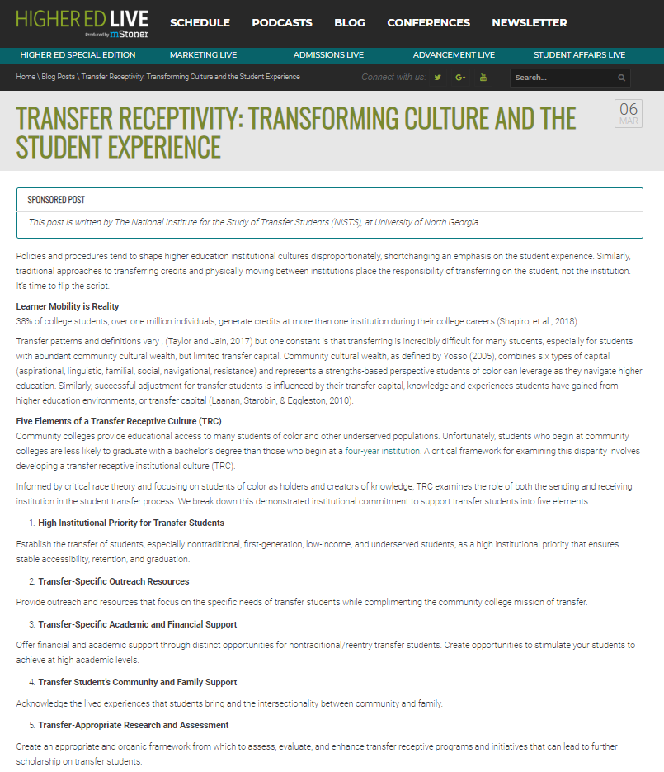
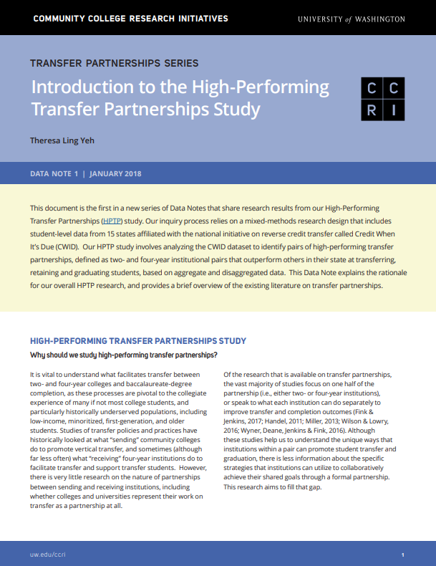
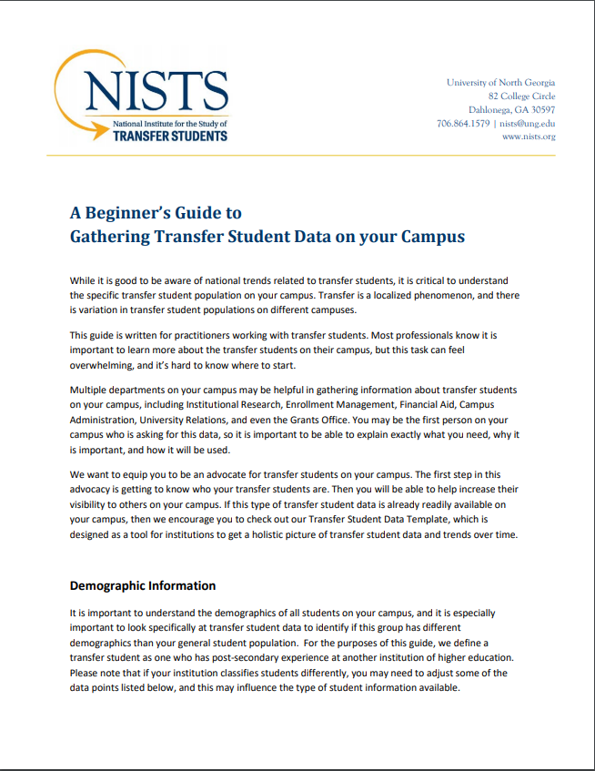
TRANSFER ADVOCACY

Slide 49
TRANSFER ADVOCACY
TRANSFERS NEED CHAMPIONS!
It’s our job to influence change.

Slide 50
YOUR SPHERE OF INFLUENCE

Slide 51
Notes:
Call to Action!

Slide 52
PUTTING IT
ALL TOGETHER
What questions do you have?
How will you embrace your transfer lenses?
Notes:
Janet

Slide 53


Slide 54
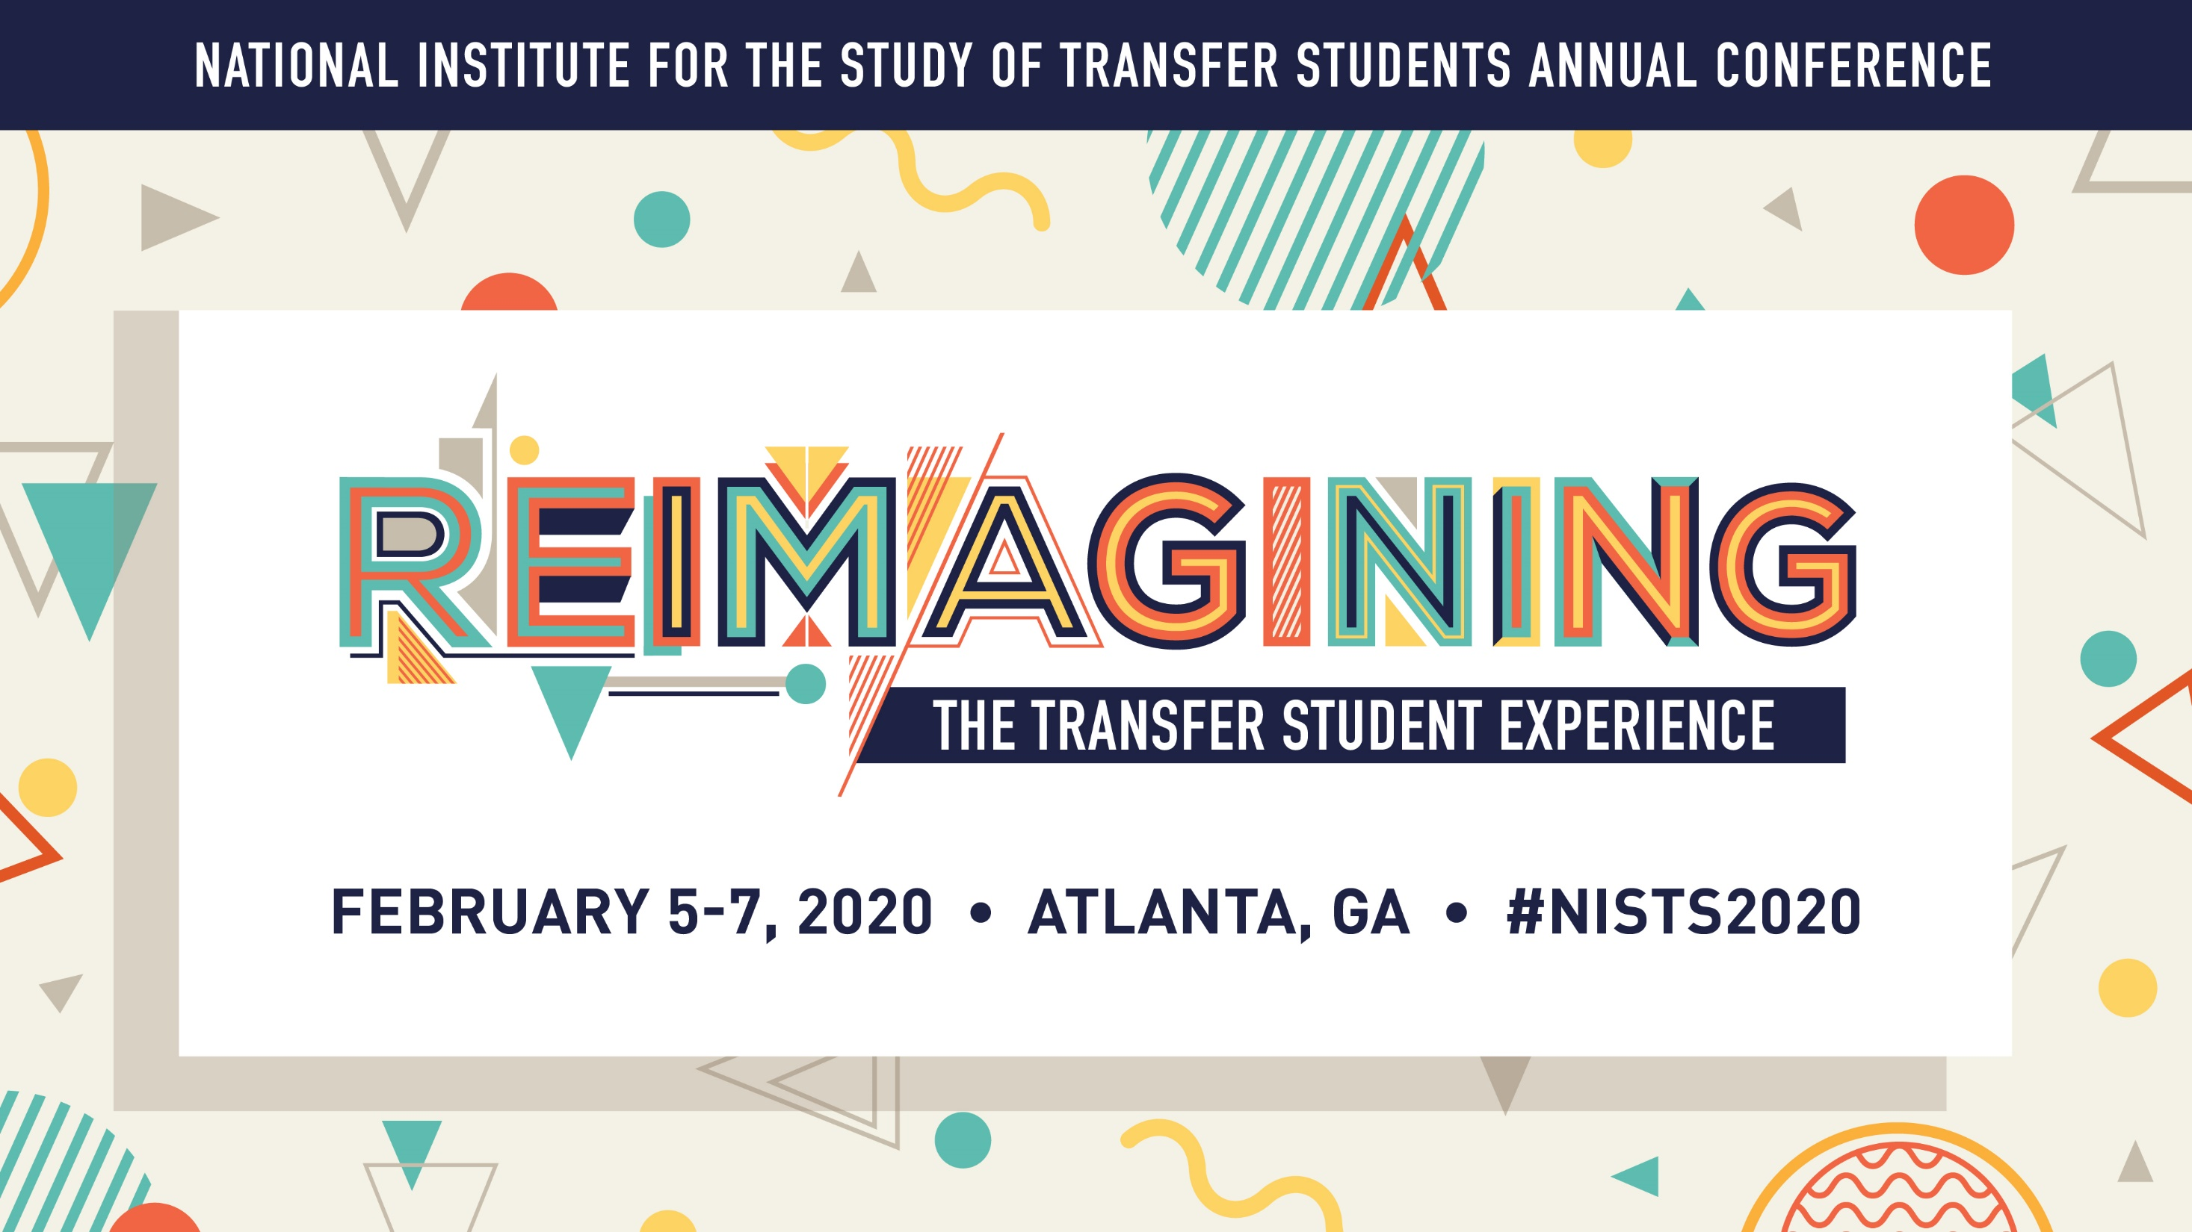
Notes:
Janet
Thank you, find us, etc.

Slide 55
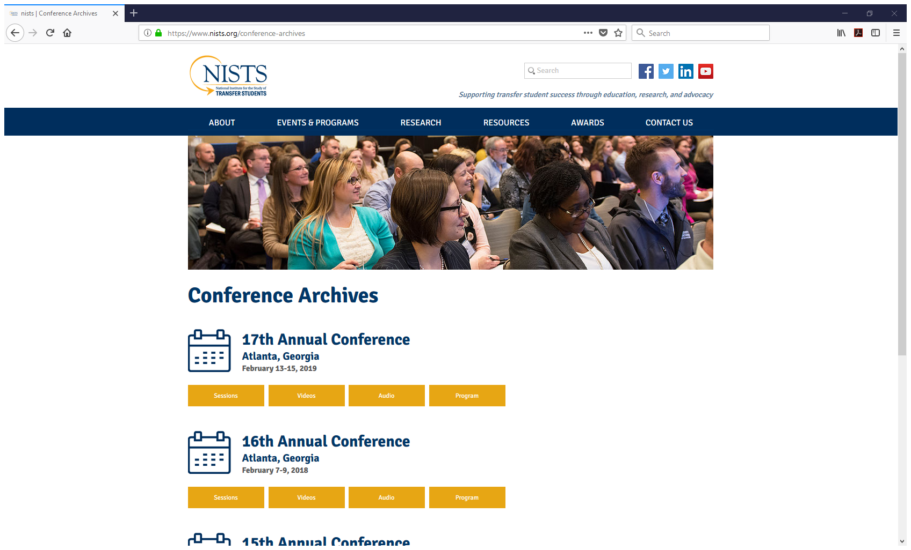

Slide 56

NISTS ANNUAL AWARDS

Slide 57





Emily Kittrell, M.S.
Assistant Director
www.nists.org
emily.kittrell@ung.edu

Slide 58
REFERENCES
Achieving the Dream (2018). Holistic student supports redesign: A toolkit for redesigning advising and student services to effectively support every student. Retrieved from: https://www.achievingthedream.org/resource/17502/holistic-student-supports-redesign-a-toolkit.
American Association of Community Colleges (2018). AACC fast facts 2018. Retrieved from https://www.aacc.nche.edu/research-trends/fast-facts/
Deane, K.C., Fink, J., Gordon, M., Jenkins, D., Kadlec, A., & Wyner, J. (2017) Tackling transfer: A guide to convening community colleges and universities to improve transfer student outcomes. Retrieved from https://ccrc.tc.columbia.edu/publications/tackling-transfer-guide-convening-community-colleges-universities-improve-transfer-student-outcomes.html
Education Design Lab (2019). Seamless transfer pathways: Student-centered solutions to improve transfer student success. Retrieved from https://eddesignlab.org/stp/
Higher Ed Live (2019, March 19). Marketing Live–Transfer receptivity: Transforming culture and the student experience. [Audio Podcast]. Retrieved from http://listen.higheredlive.com/e/marketing-live-transfer-receptivity-transforming-culture-and-the-student-experience/
Jenkins, D., & Fink, J. (2016). Tracking transfer: New measures of institutional and state effectiveness in helping community college students attain bachelor’s degrees. Retrieved from https://ccrc.tc.columbia.edu/publications/tracking-transfer-institutional-state-effectiveness.html
National Institute for the Study of Transfer Students (2016). A beginner’s guide to gathering transfer student data on your campus. Retrieved from https://www.nists.org/guide-to-gathering-transfer-student.
National Institute for the Study of Transfer Students (2019). Transfer receptivity: Transforming culture and the student experience. Retrieved from https://higheredlive.com/transfer-receptivity-transforming-culture-and-the-student-experience/
Rassen, E., Chaplot, P., Jenkins, P. D., & Johnstone, R. (2013). Understanding the student experience through the loss/momentum framework: Clearing the path to completion. Retrieved from https://ccrc.tc.columbia.edu/publications/understanding-student-experience-cbd.html

Slide 59
REFERENCES (continued)
Schudde, L., Bradley, D., & Absher, C. (2018). Ease of access and usefulness of transfer information on community college websites in Texas. Retrieved from https://ccrc.tc.columbia.edu/publications/ease-access-usefulness-transfer-information-community-college-websites-texas.html
Shapiro, D. (2018). Student transfer and mobility: Pathways, scale, and outcomes for student success. In M.A. Poisel & S. Joseph (Eds.), Building transfer student pathways for college and career success (p. 1-16). Columbia, SC: University of South Carolina, National Resource Center for the First Year Experience & Students in Transition and the National Institute for the Study of Transfer Students.
Shapiro, D., Dundar, A., Huie, F., Wakhungu, P.K., Bhimdiwali, A., Nathan, A., & Youngsik, H. (2018). Transfer and mobility: A national view of student movement in postsecondary institutions, fall 2011 cohort (Signature Report No. 15). Retrieved from https://nscresearchcenter.org/signaturereport15/
Taylor, J. L. & Jain, D. (2017). The multiple dimensions of transfer: Examining the transfer function in American higher education. Community College Review, 45(4), 273-293.
U.S. Government Accountability Office. (2017). Higher education: Students need more information to help reduce challenges in transferring college credits, GAO-17-574. Retrieved from https://www.gao.gov/products/GAO-17-574
Wyner, J., Deane, K., Jenkins, D., & Fink, J. (2016). The transfer playbook: Essential practices for two- and four-year colleges. Retrieved from https://ccrc.tc.columbia.edu/publications/transfer-playbook-essential-practices.html
Yeh, T.L. (2018). Introduction to high-performing transfer partnerships study. Retrieved from http://www.washington.edu/ccri/research/transfer/
Graphic elements: https://www.freepik.com/

